Slide 1
Hashing in Java

Slide 2
Efficiency
 | add | remove | find
unsorted array | O(1) | O(n) | O(n)
sorted array | O(n) | O(n) | O(logN)
unsorted linked list | O(1) | O(n) | O(n)
sorted linked list | O(n) | O(n) | O(n)
binary search tree | O(logN) | O(logN) | O(logN)
hash table | O(1) | O(1) | O(1)

Slide 3
Hash Functions
Maps a key to a number
  result should be constrained to some range
  passing in the same key should always give the same result
Keys should be distributed over a range
  very bad if everything hashes to 1!
  should "look random"
How would we write a hash function for String objects?
Notes:
first letter? length of word? Sum of ASCII values?
Hash functions have to be stable: same input must always generate same output

Slide 4
Hashing objects
All Java objects contain the following method:
  public int hashCode()
  Returns an integer hash code for this object.
  We can call hashCode on any object to find its preferred index.
How is hashCode implemented?
  Depends on the type of object and its state.
    Example: a String's hashCode adds the ASCII values of its letters.
  You can write your own hashCode methods in classes you write.
    All classes come with a default version based on memory address.
Notes:
Hash function can be as simple as object.hashCode() % size of container.
Maybe mention that if you decide to add a hashCode, you should also implement equals

Slide 5

String's hashCode
The hashCode function inside String objects could look like this:
  public int hashCode() {
  int hash = 0;
  for (int i = 0; i < this.length(); i++) {
  hash = 31 * hash + this.charAt(i);
  }
  return hash;
  }
  As with any general hashing function, collisions are possible.
    Example: "Ea" and "FB" have the same hash value.
  Early versions of Java examined only the first 16 characters.
  For some common data this led to poor hash table performance.
Notes:
One implementation of Java hashCode for strings. One idea of how you could add a hashCode to any object that you want to write.

Slide 6
Collisions
collision: When hash function maps 2 values to same index.
  set.add(11);
  set.add(49);
  set.add(24);
  set.add(7);
  set.add(54); // collides with 24!
collision resolution: An algorithm for fixing collisions.
index | 0 | 1 | 2 | 3 | 4 | 5 | 6 | 7 | 8 | 9
value | 0 | 11 | 0 | 0 | 54 | 0 | 0 | 7 | 0 | 49

Slide 7
Probing
probing: Resolving a collision by moving to another index.
  linear probing: Moves to the next index.
  set.add(11);
  set.add(49);
  set.add(24);
  set.add(7);
  set.add(54); // collides with 24; must probe
  Is this a good approach?
    variation: quadratic probing moves increasingly far away
index | 0 | 1 | 2 | 3 | 4 | 5 | 6 | 7 | 8 | 9
value | 0 | 11 | 0 | 0 | 24 | 54 | 0 | 7 | 0 | 49

Slide 8
Clustering
clustering: Clumps of elements at neighboring indexes.
  slows down the hash table lookup; you must loop through them.
  set.add(11);
  set.add(49);
  set.add(24);
  set.add(7);
  set.add(54); // collides with 24
  set.add(14); // collides with 24, then 54
  set.add(86); // collides with 14, then 7
  How many indexes must a lookup for 94 visit?
index | 0 | 1 | 2 | 3 | 4 | 5 | 6 | 7 | 8 | 9
value | 0 | 0 | 0 | 0 | 0 | 0 | 0 | 0 | 0 | 0
index | 0 | 1 | 2 | 3 | 4 | 5 | 6 | 7 | 8 | 9
value | 0 | 11 | 0 | 0 | 24 | 54 | 14 | 7 | 86 | 49
Notes:
Now a lookup for 94 must look at 7 out of 10 total indexes.
This gets worse if you remove an element. Now do you shift everything back an index?
Or what if you get too full?

Slide 9
Chaining
chaining: Resolving collisions by storing a list at each index.
  add/search/remove must traverse lists, but the lists are short
  impossible to "run out" of indexes, unlike with probing
index | 0 | 1 | 2 | 3 | 4 | 5 | 6 | 7 | 8 | 9
value
11
24
7
49
54
14

Slide 10
Rehashing
rehash: Growing to a larger array when the table is too full.
  Cannot simply copy the old array to a new one. (Why not?)
load factor: ratio of (# of elements ) / (hash table length )
  many collections rehash when load factor ≅ .75
  can use big prime numbers as hash table sizes to reduce collisions
0 | 1 | 2 | 3 | 4 | 5 | 6 | 7 | 8 | 9 | 10 | 11 | 12 | 13 | 14 | 15 | 16 | 17 | 18 | 19
24
7
49
11
54
14

Slide 11
Rehashing code
...
// Grows hash array to twice its original size.
private void rehash() {
List<Integer>[] oldElements = elements;
elements = (List<Integer>[])
new List[2 * elements.length];
for (List<Integer> list : oldElements) {
if (list != null) {
for (int element : list) {
add(element);
}
}
}
}

Slide 12
Other questions
How would we implement toString on a HashSet?
index | 0 | 1 | 2 | 3 | 4 | 5 | 6 | 7 | 8 | 9
value
11
24
7
49
54
current element: 24
current index: 4
sub-index: 0
iterator
14

Slide 13
Implementing a hash map
A hash map is just a set where the lists store key/value pairs:
  // key value
  map.put("Marty", 14);
  map.put("Jeff", 21);
  map.put("Kasey", 20);
  map.put("Stef", 35);
  Instead of a List<Integer>, write an inner Entry node class with key and value fields; the map stores a List<Entry>
index | 0 | 1 | 2 | 3 | 4 | 5 | 6 | 7 | 8 | 9
value
"Stef" | 35
"Marty" | 14
"Jeff" | 21
"Kasey" | 20

Slide 14
Runtime of hashing
the load factor λ is the fraction of the table that is full
  λ = 0 (empty) λ = 0.5 (half full) λ = 1 (full table)
Linear probing:
  If hash function is fair and λ < 0.5 - 0.6, then hashtable operations are all O(1)
Double hashing:
  If hash function is fair and λ < 0.9 - 0.95, then hashtable operations are all O(1)

Slide 15
Rehashing
rehash: increasing the size of a hash table's array, and re-storing all of the items into the array using the hash function
  Can we just copy the old contents to the larger array?
When should we rehash?
  when table is half full
  when an insertion fails
  when load reaches a certain level (best option)

Slide 16
Rehashing (cont’d)
What is the cost (Big-Oh) of rehashing?
  O(n). Isn’t that bad?
How much bigger should a hash table get when it grows?
  What is a good hash table array size?
    Find next prime that is at least twice the current table’s size

Slide 17
Hashing practice problem
Draw a diagram of the state of a hash table of size 10, initially empty, after adding the following elements.
  h(x) = x mod 10 as the hash function.
  Assume that the hash table uses linear probing.
  Assume that rehashing occurs at the start of an add where the load factor is 0.5.
  7, 84, 31, 57, 44, 19, 27, 14, and 64
Repeat the problem above using quadratic probing.

Slide 18
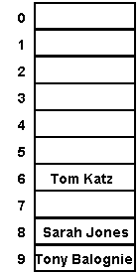
How do we hash different objects in Java?
Every object that will be hashed should define a reasonably unique hash code
  public int hashCode() in class Object
Hash tables will index elements in array by hashCode() value
  If using separate chaining, we just have to check that one index to see if it's there: O(1)*
    "Tom Katz".hashCode() % 10 == 6
    "Sarah Jones".hashCode() % 10 == 8
    "Tony Balognie".hashCode() % 10 == 9
    * Assuming chains are not too long

Slide 19
Error: not overriding equals
public class Point {
private int x, y;
public Point(int x, int y) {
this.x = x;
this.y = y;
}
// No equals!
}
The following code prints false!
ArrayList<Point> p = new ArrayList<Point>();
p.add(new Point(7, 11));
System.out.println(p.contains(new Point(7, 11)));

Slide 20
Membership testing in ArrayList in Java
When searching for a given object (contains):
  Java compares the given object with objects in the ArrayList using the object’s equals method
Override the Employee's equals method.

Slide 21
Error: overriding equals but not hashCode
public class Point {
private int x, y;
public Point(int x, int y) {
this.x = x;
this.y = y;
}
public boolean equals(Object o) {
if (o == this) { return true; }
if (!(o instanceof Point)) { return false; }
Point p = (Point)o;
return p.x == this.x && p.y == this.y;
}
// No hashCode!
}
The following code prints false!
HashSet<Point> p = new HashSet<Point>();
p.add(new Point(7, 11));
System.out.println(p.contains(new Point(7, 11)));

Slide 22
Membership testing in HashSet in Java
When searching for a given object (contains):
  The set computes the hashCode for the given object
  It looks in the chain at that index of the HashSet's internal array
  Java compares the given object with objects in the HashSet using the object’s equals method
General contract: if equals is overridden, hashCode should be overridden also; equal objects must have equal hash codes

Slide 23
Overriding hashCode
Conditions for overriding hashCode:
  Return same value for object whose state hasn’t changed since last call
  If x.equals(y), then x.hashCode() == y.hashCode()
  If !x.equals(y), it is not necessary that x.hashCode() != y.hashCode()
    Why not?
Advantages of overriding hashCode
  Your objects will store themselves correctly in a hash table
  Distributing the hash codes will keep the hash balanced: no one bucket will contain too much data compared to others
public int hashCode() {
int result = 37 * x;
result = result + y;
return result;
}

Slide 24
Overriding hashCode, cont’d.
Things to do in a good hashCode implementation
  Make sure the hash code is same for equal objects
  Try to ensure that the hash code will be different for different objects
  Try to ensure that the hash code depends on every piece of state that is used in equals
    What if you don’t?
      Strings prior to Java 1.2 only considered the first 16 letters. What is wrong with this?
  Preferably, weight the pieces so that different objects won’t happen to add up to the same hash code
Override the Employee's hashCode method.

Slide 25
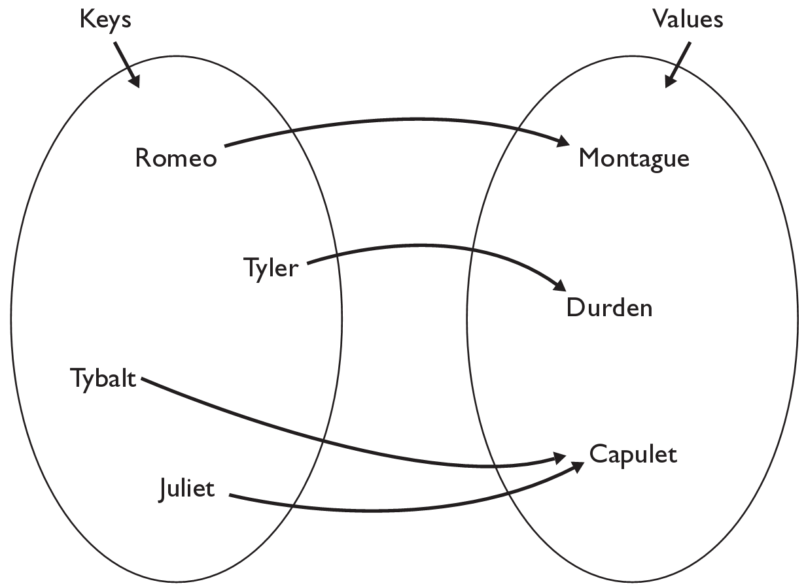
The Map ADT
map: Holds a set of unique keys and a collection of values, where each key is associated with one value
  a.k.a. "dictionary", "associative array", "hash"
basic map operations:
  put(key, value): Adds a
  mapping from a key to
  a value.
  get(key): Retrieves the
  value mapped to the key.
  remove(key): Removes
  the given key and its
  mapped value.
myMap.get("Juliet") returns "Capulet"

Slide 26
Maps in computer science
Compilers
  Symbol table
Operating Systems
  File systems (file name → location)
Real world Examples
  Names to phone numbers
  URLs to IP addresses
  Student ID to student information

Slide 27
Using Maps
In Java, maps are represented by the Map interface in java.util
Map is implemented by the HashMap and TreeMap classes
  HashMap: implemented with hash table; uses separate chaining
  extremely fast: O(1) ; keys are stored in unpredictable order
  TreeMap: implemented with balanced binary search tree;
  very fast: O(log N) ; keys are stored in sorted order
  A map requires 2 type parameters: one for keys, one for values.
// maps from String keys to Integer values
Map<String, Integer> votes = new HashMap<String, Integer>();

Slide 28
Map methods
put(key, value) | adds a mapping from the given key to the given value; if the key already exists, replaces its value with the given one
get(key) | returns the value mapped to the given key (null if not found)
containsKey(key) | returns true if the map contains a mapping for the given key
remove(key) | removes any existing mapping for the given key
clear() | removes all key/value pairs from the map
size() | returns the number of key/value pairs in the map
isEmpty() | returns true if the map's size is 0
toString() | returns a string such as "{a=90, d=60, c=70}"
keySet() | returns a set of all keys in the map
values() | returns a collection of all values in the map
putAll(map) | adds all key/value pairs from the given map to this map
equals(map) | returns true if given map has the same mappings as this one

Slide 29
keySet and values
keySet() returns a Set of all keys in the map
  Can loop over the keys in a foreach loop
  Can get each key's associated value by calling get on the map
  Map<String, Integer> ages = new TreeMap<String, Integer>();
  ages.put("Meghan", 29);
  ages.put("Kona", 3); // ages.keySet() returns Set<String>
  ages.put("Daisy", 1);
  for (String name : ages.keySet()) { // Daisy -> 1
  int age = ages.get(name); // Kona -> 3
  System.out.println(name + " -> " + age); // Meghan -> 29
  }
values() returns a collection of values in the map
  Can loop over the values in a foreach loop
  No easy way to get from a value to its associated key(s)

Slide 30
Implementing Map with Hash Table
Each map entry adds a new key → value pair to the map
  Entry contains:
    key element of given key type (null is a valid key value)
    value element of given value type
    additional information needed to maintain hash table
Organized for super quick access to keys
  The keys are what we will be hashing on

Slide 31
Implementing Map with Hash Table, cont.
public interface Map<K, V> {
public boolean containsKey(K key);
public V get(K key);
public void print();
public void put(K key, V value);
public V remove(K key);
public int size();
}

Slide 32
HashMapEntry
public class HashMapEntry<K, V> {
public K key;
public V value;
public HashMapEntry<K, V> next;
public HashMapEntry(K key, V value) {
this(key, value, null);
}
public HashMapEntry(K key, V value, HashMapEntry<K, V> next) {
this.key = key;
this.value = value;
this.next = next;
}
}

Slide 33
Map implementation: put
Similar to our Set implementation's add method
  Figure out where key would be in the map
  If it is already there replace the existing value with the new value
  If the key is not in the map, insert the key, value pair into the map as a new map entry

Slide 34
Map implementation: put
public void put(K key, V value) {
int keyBucket = hash(key);
HashMapEntry<K, V> temp = table[keyBucket];
while (temp != null) {
if ((temp.key == null && key == null)
|| (temp.key != null && temp.key.equals(key))) {
temp.value = value;
return;
}
temp = temp.next;
}
table[keyBucket] = new HashMapEntry<K, V>(key, value, table[keyBucket]);
size++;
}

